Slide 1
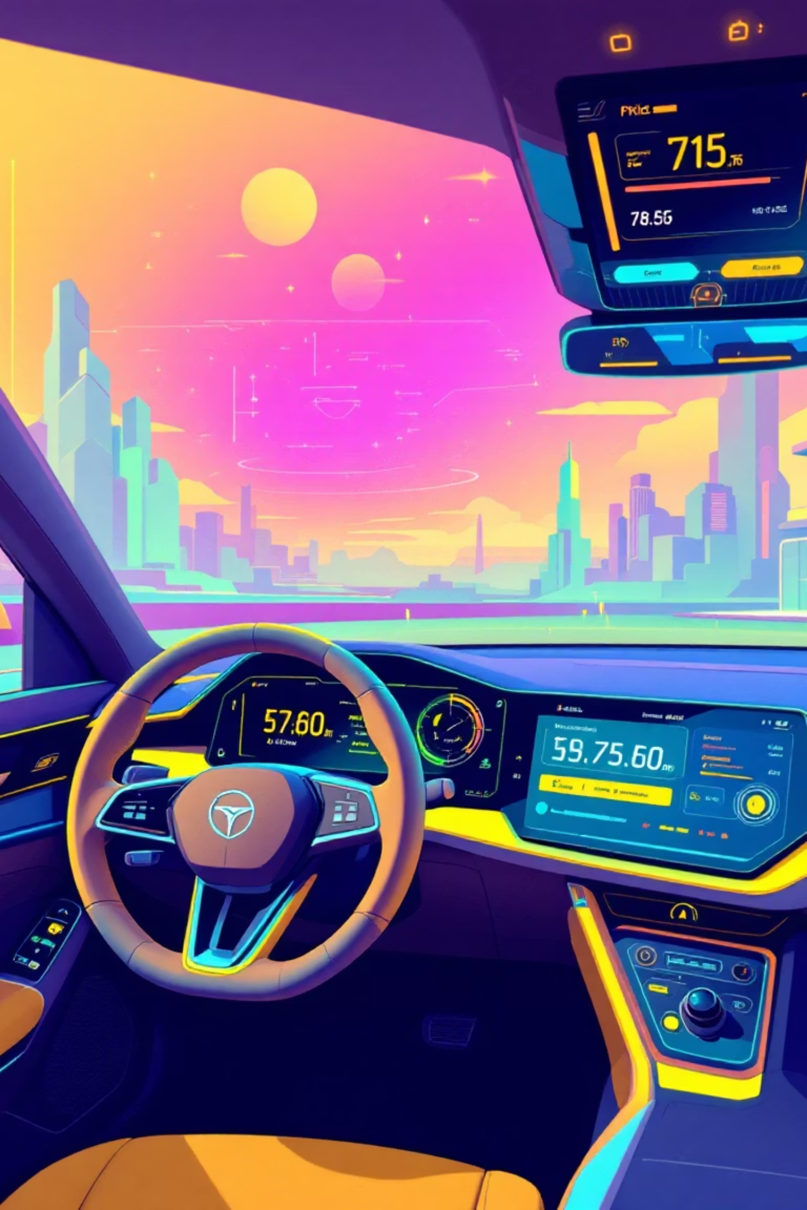
End-to-End Car Price Prediction
Author: Abdelrahman Solii
Date: 2025-12-07

Slide 2

Project Abstract & Introduction
This project aims to predict car resale prices using machine learning, addressing the used car market's inconsistent pricing and lack of transparency. We develop a model that accurately estimates car prices and includes a web interface for real-time predictions.
Automate Estimation
Analyze Datasets
Provide accurate and reliable price predictions.
Understand features impacting car prices.
Deploy Model
User-friendly web interface for predictions.

Slide 3
Dataset Overview
Our dataset contains car features crucial for price prediction, collected from online listings and historical sales data.
manufacturer
Car brand (e.g., Toyota, Hyundai)
model
Car model name
mileage
Distance driven in km
engine_volume
Engine size in liters
car_age
Age in years
price
Selling price (target variable)

Slide 4
Data Preprocessing Steps
Before modeling, data underwent rigorous preprocessing to ensure accuracy and consistency.
01
02
03
Missing Values
Duplicate Records
Feature Engineering
Handled using mean/mode imputation.
Removed to avoid bias in the model.
Calculated car_age and price_per_mileage.
04
05
Categorical Encoding
Train/Test Split
Used LabelEncoder for various features.
80% training, 20% testing for model validation.

Slide 5
Exploratory Data Analysis (EDA)
Key observations from data visualization revealed significant correlations impacting car prices.
1
2
3
Price Distribution
Manufacturer Impact
Mileage vs. Price
Average car price: $18,559, median: $13,172.
BMW, Mercedes show higher mean prices.
Negative correlation; higher mileage means lower price.
4
5
Engine & Power
Fuel Type & Category
Positive correlation with price.
SUVs and diesel cars tend to be more expensive.

Slide 6
Model Selection & Training
Several regression models were tested, with CatBoost Regressor emerging as the top performer.
CatBoost Regressor
0.9998
166.75
XGBoost Regressor
0.9982
469.53
Linear Regression
[INSERT]
[INSERT]
The CatBoost Regressor was selected for its superior accuracy and stability, trained with default parameters and early stopping.

Slide 7

Model Evaluation
The CatBoost model demonstrated exceptional performance on the test set.
0.9998
166.75
941.575
R² Score
RMSE
RMSE
Indicates excellent fit to data.
Low error in price prediction.
Another measure of prediction accuracy.
Top features influencing price include mileage, engine volume, car age, and manufacturer/model mean prices.

Slide 8


Deployment Strategy
The trained model is deployed for real-time predictions using Streamlit and Gunicorn, ensuring accessibility and scalability.
Install Dependencies
Run Locally
python car_pred_price.py
pip install -r requirements.txt
Via Gunicorn
gunicorn car_pred_price:app --bind 0.0.0.0:5000

Slide 9

Conclusion & Future Work
The CatBoost model provides highly accurate car price predictions, driven by key factors like mileage and engine volume.
Conclusion
Future Work
Highly accurate predictions with CatBoost.
Incorporate location, demand trends, accident history.
Key factors: mileage, engine volume, car age, manufacturer/model averages.
Develop a full web platform with user accounts.
Explore ensemble models for enhanced accuracy.

Slide 10

References
Further information and resources can be found through these references:
Scikit-learn Documentation
https://scikit-learn.org/
CatBoost Documentation
https://catboost.ai/
Used Car Price Prediction Examples
Analytics Vidhya

